Slide 1
Patterns of student success when learning SQL
Nathan Garrett, PhD CPA (WV)
Teaching Assistant Professor, West Virginia University
AAA CTLA 2024

Slide 2
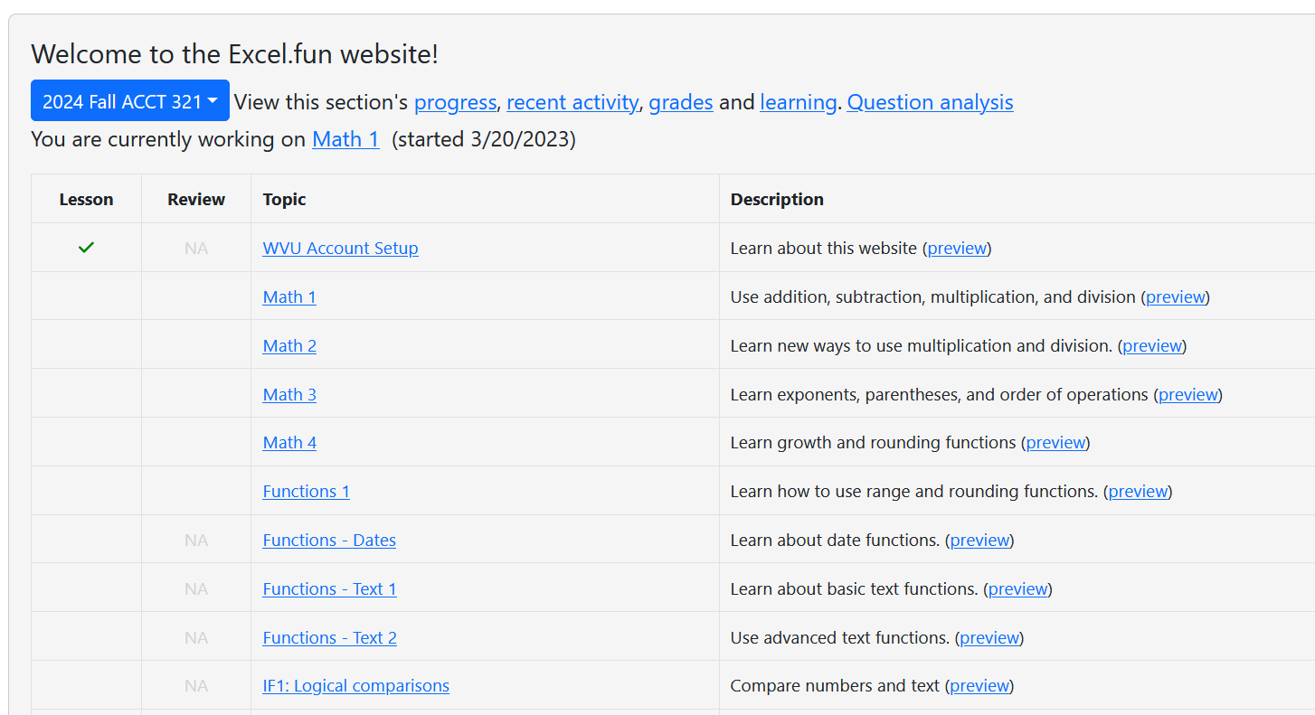
Excel.fun website
Notes:
Hobby website,

Slide 3
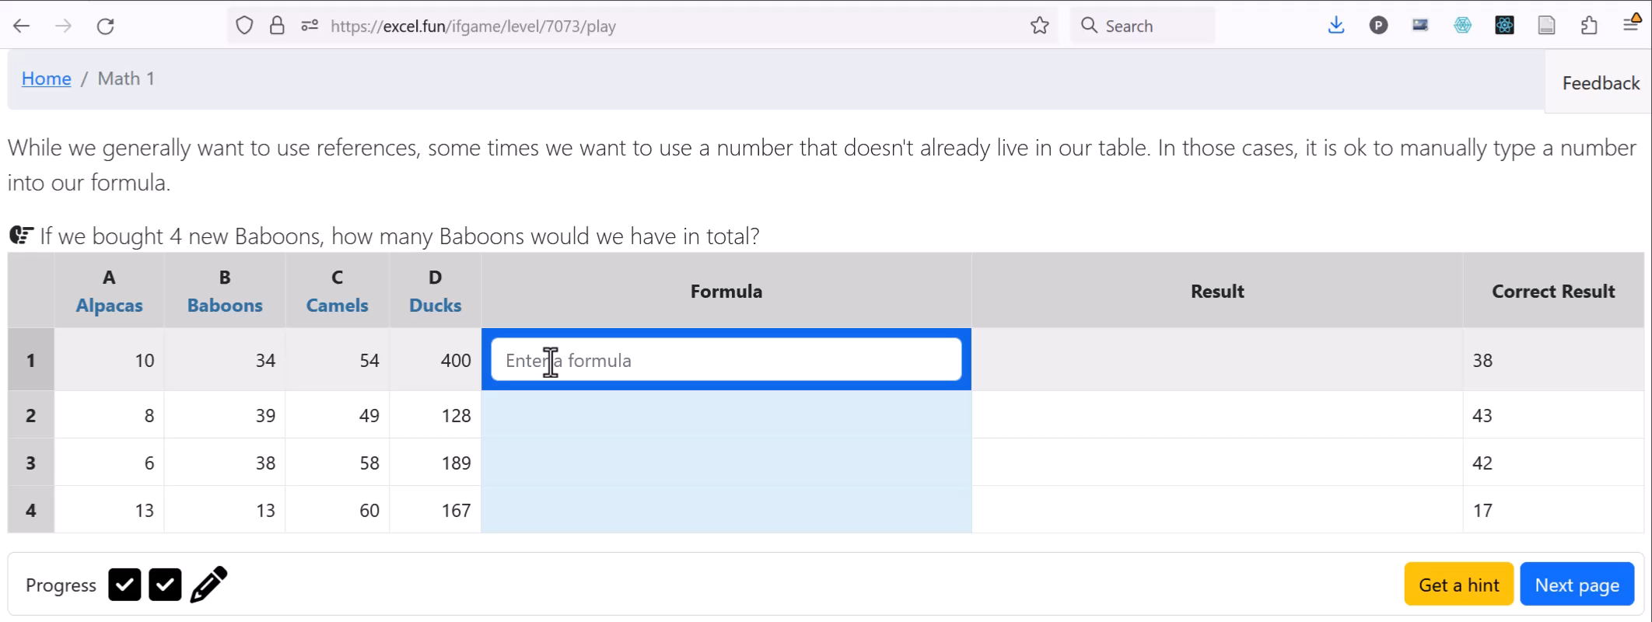
Hints, errors, and yes/no feedback

Slide 4
SQL tutorials
Instructional Goals:
Easy progression
Reinforce prior learning outcomes
Tutorial to Quiz progress
4-6 tutorial pages, 5 quiz problems
Video and in-class introduction
Select / From
Order By
Where
And / Or
Inner Join
Left Outer Join
Key Practice
Self-join
Group By

Slide 5
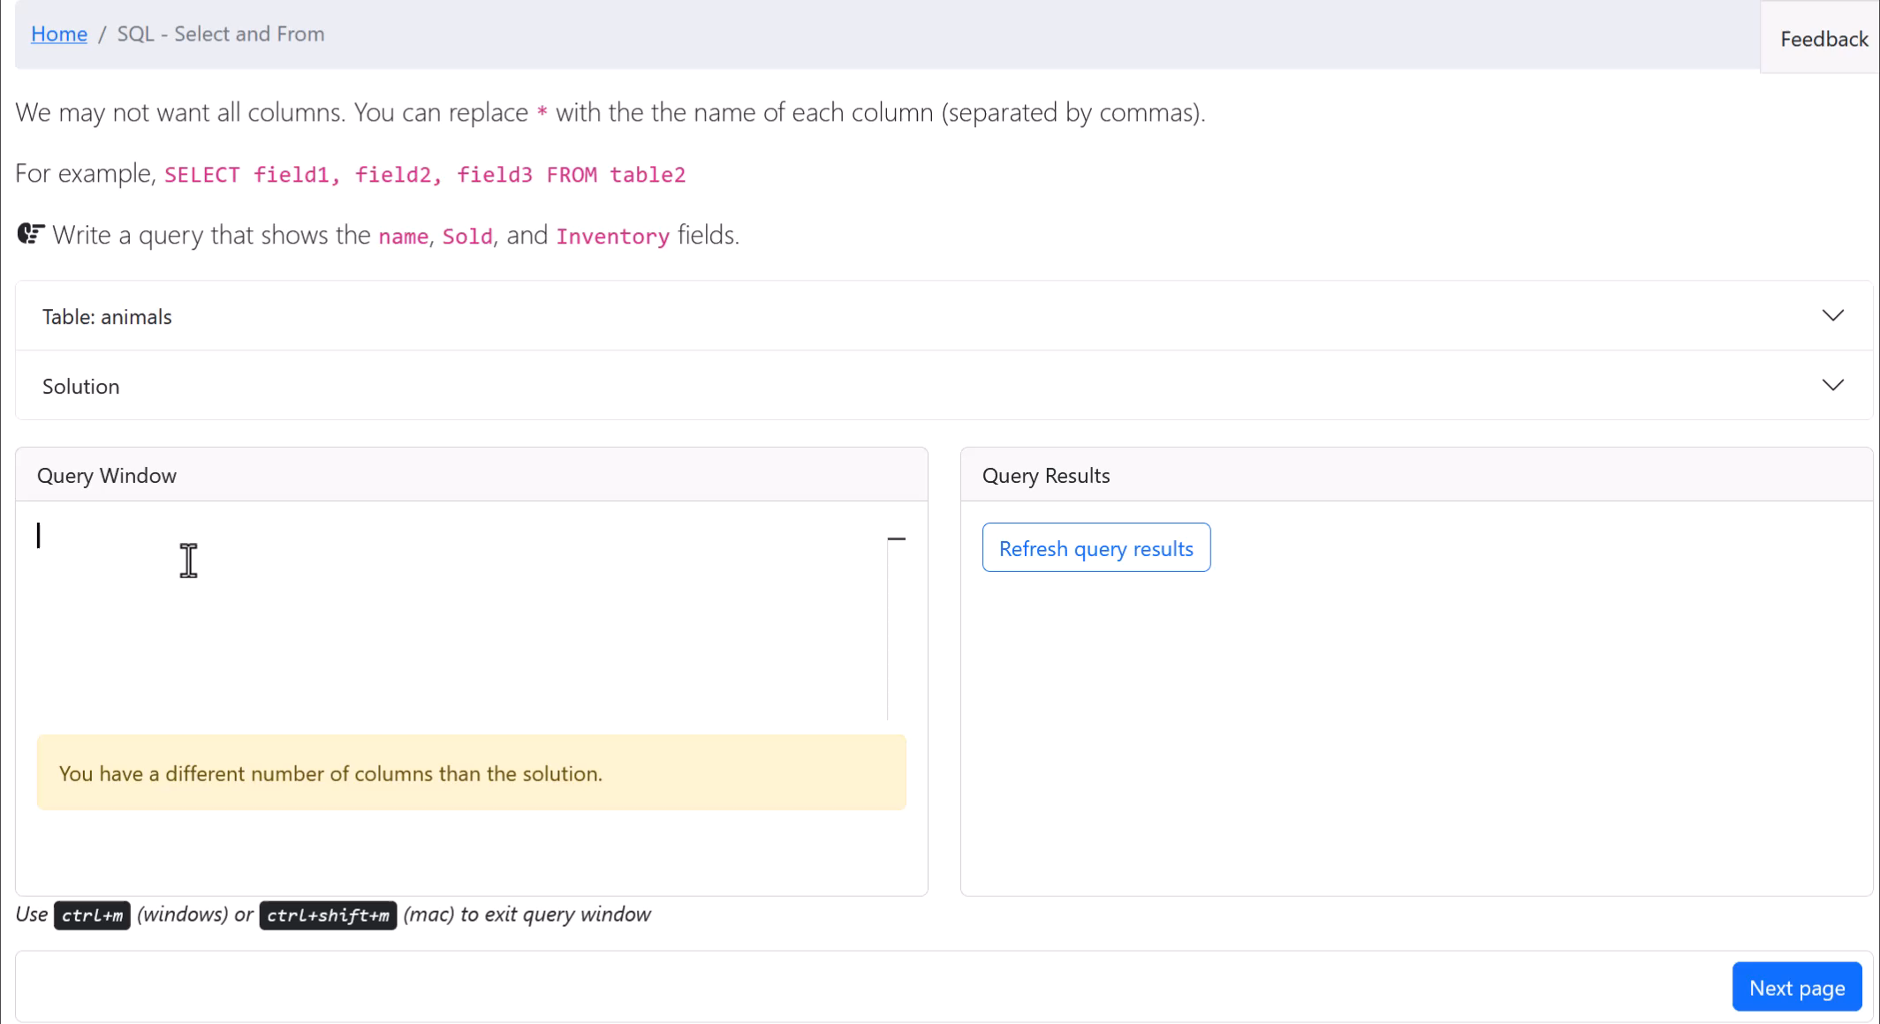
Source & destination table, autocomplete, visualize results, error messages but no hints

Slide 6
Core problem – success rates were too low

Slide 7
Numerous submissions per question

Slide 8
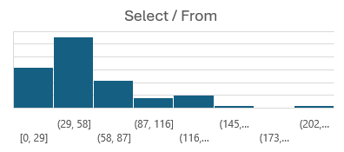
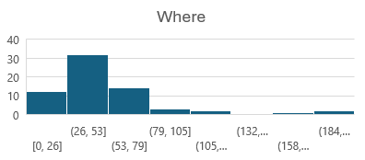
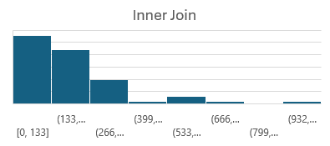
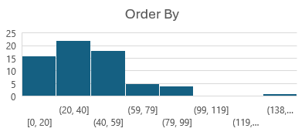
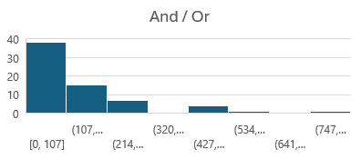
Outliers in time taken on all tutorials

Slide 9
Some students take longer, but all have occasional struggles

Slide 10
Learning Curve Analysis

Slide 11
Learning curve shows problems

Slide 12
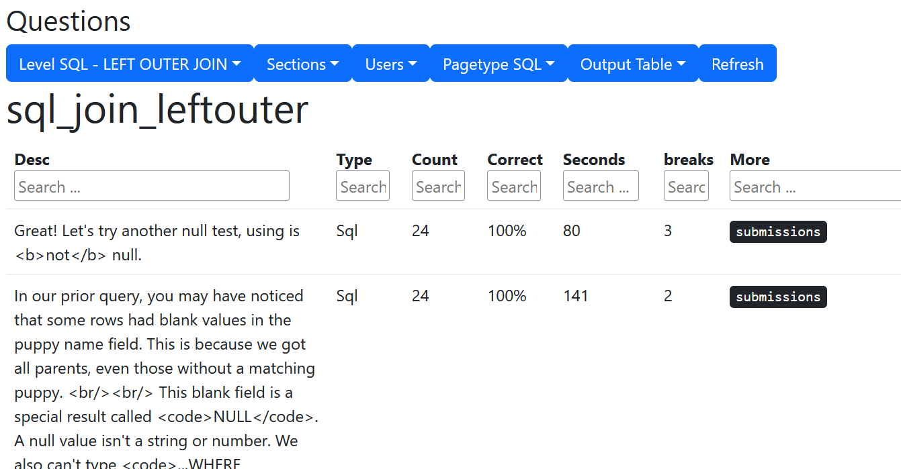

Slide 13
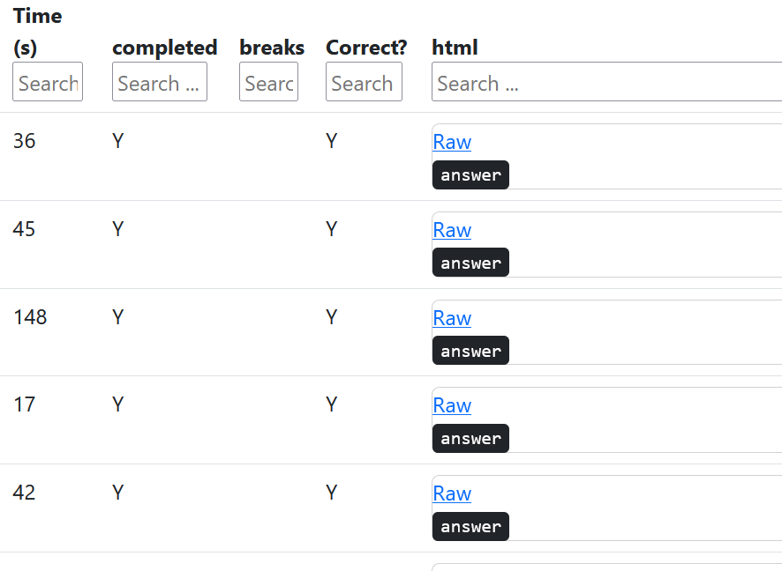
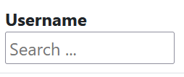

Slide 14
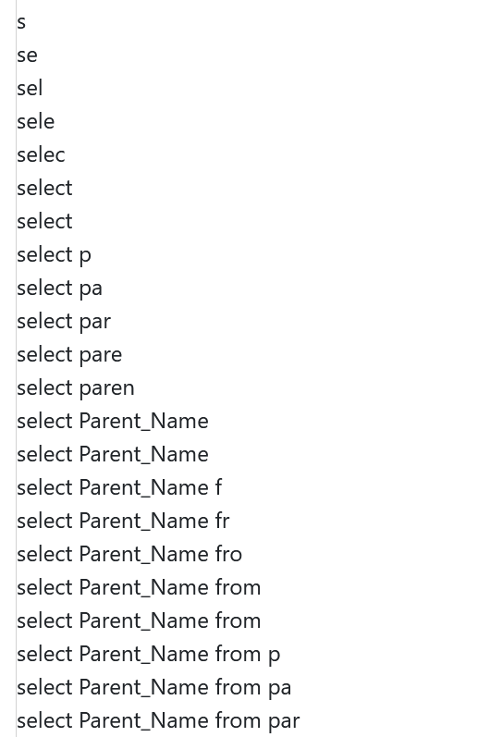

Slide 15
Select / From

Slide 16
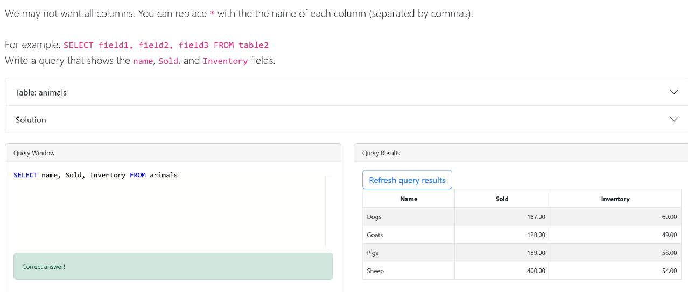
Sample of wrong answers

Slide 17
Wrong answers
SELECT field1, field4, field3 FROM TABLE animal
SELECT Name, Sold, Inventory FROM TABLE: animals
SELECT Name, Sold, Inventory FROM table2
SELECT name, sold, inventory FROM table
SELECT name, Sold, Inventory, FROM TABLE animals
SELECT * name, Sold, Inventory FROM Inventory
Table name confusion
Comma and start typos

Slide 18
Order By

Slide 19
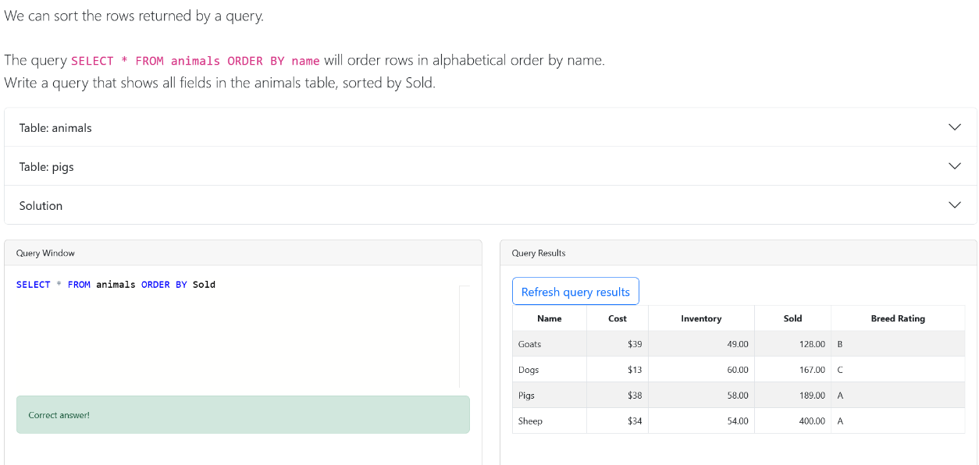

Slide 20
Sample of wrong answers
SELECT * FROM animals ORDER BY Name, Cost, Inventory, Sold, "Breed Rating" FROM animals
SELECT * Name, Cost, Inventory, Sold, Breed Rating from animals order by sold
SELECT FROM animals ORDER BY sold
Select * From ORDER by Name
SELECT * FROM animals ORDER BY Name, Cost, Inventory, Sold, "Breed Rating" FROM animals
SELECT * Name, Cost, Inventory, Sold, Breed Rating from animals order by sold
Fieldname confusion
Missing table name
Missing spaces

Slide 21
Where

Slide 22
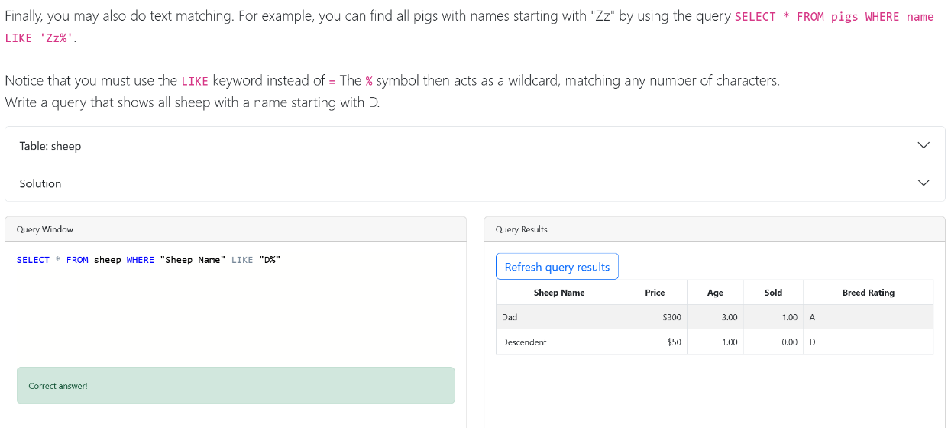

Slide 23
Sample of wrong answers
SELECT * FROM sheep WHERE Sheep Name LIKE "D%"
SELECT "Sheep Name", Price, Age, Sold, "Breed Rating" FROM sheep WHERE LIKE 'Aunt'
SELECT * FROM sheep WHERE name LIKE "Aunt"
Name quoting
Missing % wildcard

Slide 24
And / Or

Slide 25
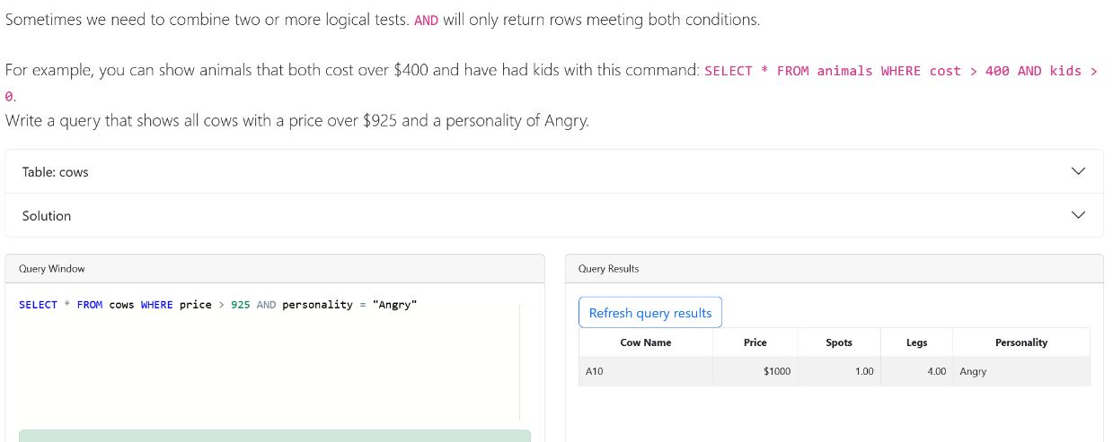

Slide 26
Sample of wrong answers
SELECT * FROM cows WHERE Price > 900 AND Personality of "Docile"
SELECT * FROM cows WHERE cost > 925 AND ANGRY
SELECT * FROM cows WHERE Price > 900 AND Personality < "Docile
SELECT * FROM cows WHERE price > 925 AND Personality > 0
SELECT * FROM cows WHERE Price > 925 AND Personality <>"docile"
SELECT * FROM Cows WHERE Price > $925 AND Personality =Angry
Name quoting
Wrong comparison operator

Slide 27
Inner Join

Slide 28
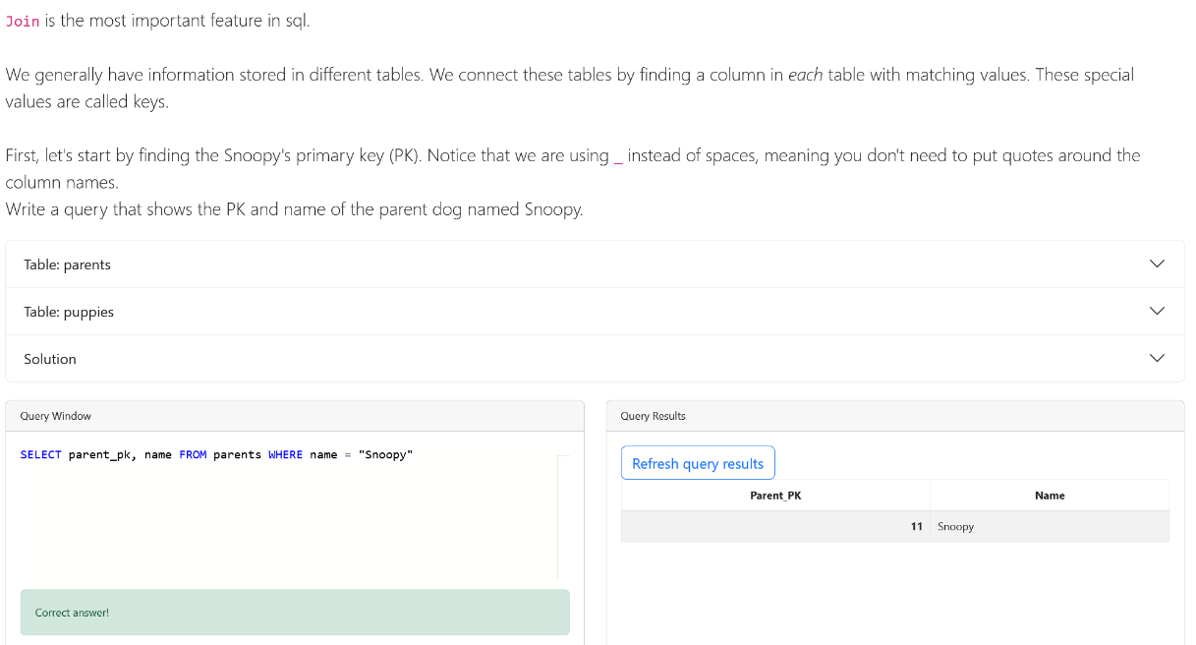

Slide 29
Sample of wrong answers
No join yet…
AND versus comma
Wrong join fields
SELECT Parent_PK, Name. FROM parents INNER JOIN puppies ON parents.Parent_PK = Snoopy
SELECT Name FROM parents INNER JOIN puppies ON parents.Parent_PK = puppies.Name
SELECT parents.Name FROM parents INNER JOIN puppies ON parents.Name = puppies.Name
SELECT Snoopy.*, parents.Name FROM parents INNER JOIN puppies ON parents.Parent_PK = puppies.FK_to_Parent
SELECT * FROM parents WHERE Parent_PK AND Name = "Snoopy"
SELECT parents.* FROM parents INNER JOIN Name ON parents
SELECT parents.* FROM parents WHERE Parent_PK = 11 AND Name = "Snoopy"
SELECT * FROM parents WHERE Name =Parent_PK ="Snoopy"
SELECT Parent_PK AND Name FROM parents WHERE Name = "Snoopy"

Slide 30
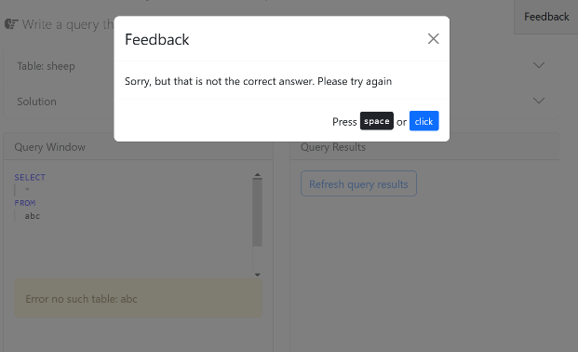
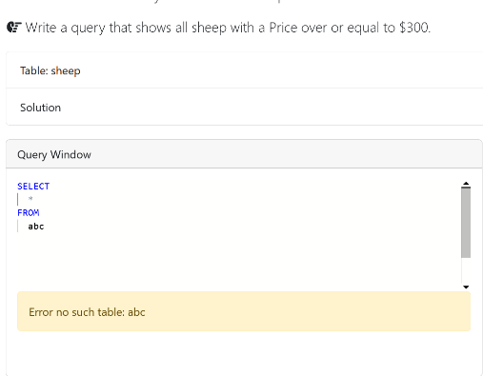
Problem with feedback
Error (but no feedback)
Timeout solution

Slide 31
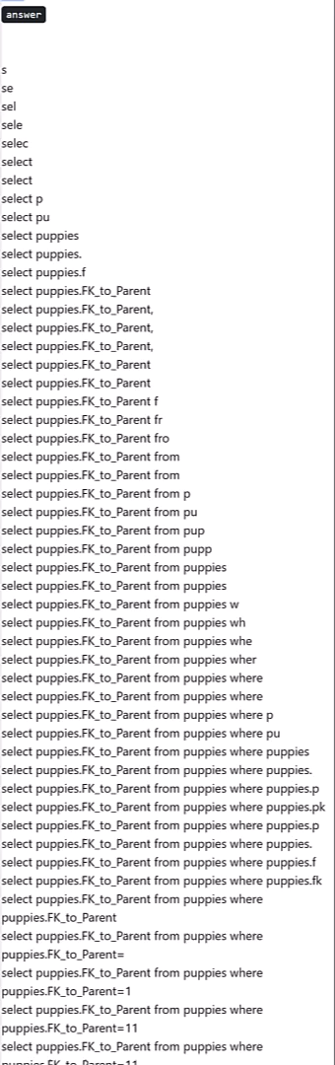
Challenges
Lots of typos
Cargo cult of prior things typed in
  Last time I typed in each column in the SELECT
  Last video used the INVENTORY table
Matching quotes is very hard (double v. single)
Field v. value confusion
Randomly typing in things in instructions without reading them
What happens when they get stuck?

Slide 32
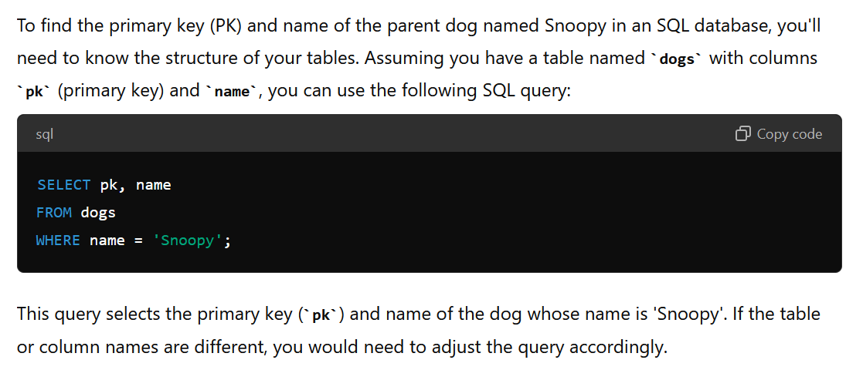
How does ChatGPT do in answering?
Give me the code for these sql questions… Write a query that shows the PK and name of the parent dog named Snoopy.

Slide 33
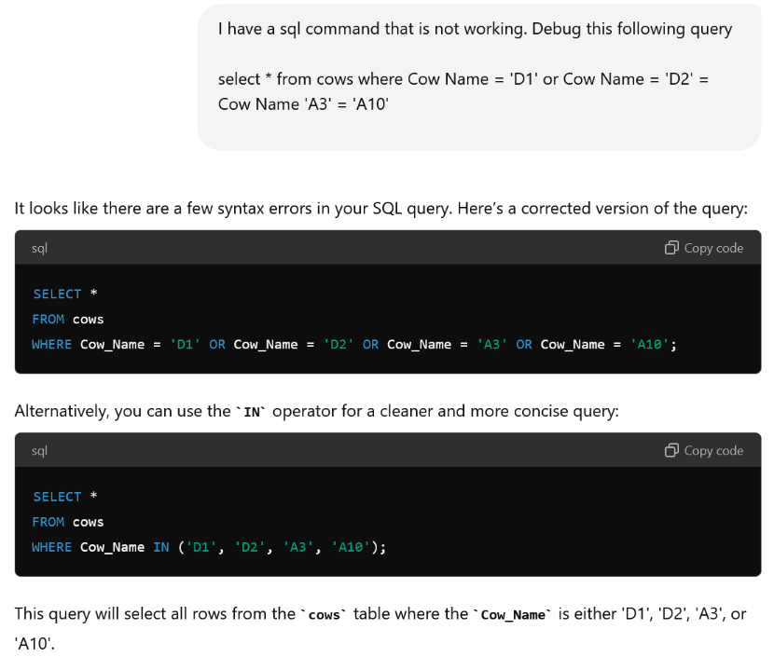

Slide 34
How to encourage students to work?
ChatGPT doesn’t know the table structure
It assumes
  Primary and foreign key names are identical
  Fields use snake_case
Automatically adds
  Semicolon at the end of each command;
  Line returns at the end of each major command
  Format (command in CAPITAL letters, with no spaces before)

Slide 35
So how many students used ChatGPT?
66 students
16 users
  2 from the beginning
  5 after a good start
  7 occasionally

Slide 38
Lessons learned
Cognitive Load Theory
  Intrinsic, extrinsic, and germane cognitive load
  Limited working memory
Split instruction
  Introduction and repetition of minimal examples
  Do not reinforce older skills
  Separate integration step
  Defer text until after core skills developed
SQL
  Quotes are very hard
  Selecting the right skill is hard
  Confusion of SELECT fields v. WHERE or ON
ChatGPT
  Allow paste, but prevent copying / drag+drop
  Don’t align with ChatGPT expectations of pk = fk name and Snake_Case
  Detect ; character

